Slide 1
Topic 2: Direct Link Network
Lecture
2
Direct-link networks
datagram
Link layer protocol
Adapter
Adapter
frame
frame
Sender
Receiver
Notes:
Credit: Jennifer Ruxford

Slide 2
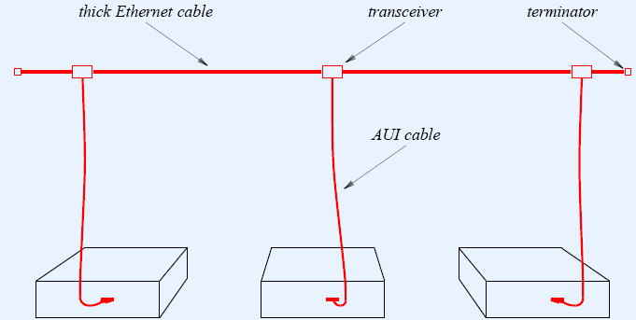
Thicknet – 10Base5
Recap
Figure from: Douglas Comer: “Computer Networks and Internets”
Notes:
Networks of any size can be built using the two building blocks: links and nodes

Slide 3
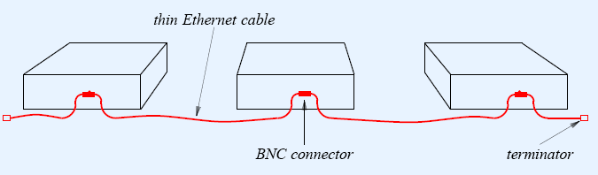
Thinnet – 10Base2
Recap
Figure from: Douglas Comer: “Computer Networks and Internets”
Notes:
Networks of any size can be built using the two building blocks: links and nodes

Slide 4
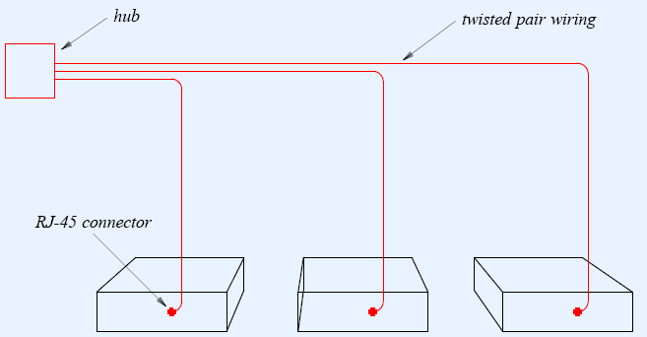
TP Ethernet – 10BaseT
Recap
Figure from: Douglas Comer: “Computer Networks and Internets”
Notes:
Networks of any size can be built using the two building blocks: links and nodes

Slide 5
Exercise
Connect the following with
10Base5; 10Base2 and 10BaseT
office 1
office 2
office 3
office 4
office 5
office 6
office 7
office 8
Figure adapted from: Douglas Comer: “Computer Networks and Internets”
Notes:
Networks of any size can be built using the two building blocks: links and nodes

Slide 6
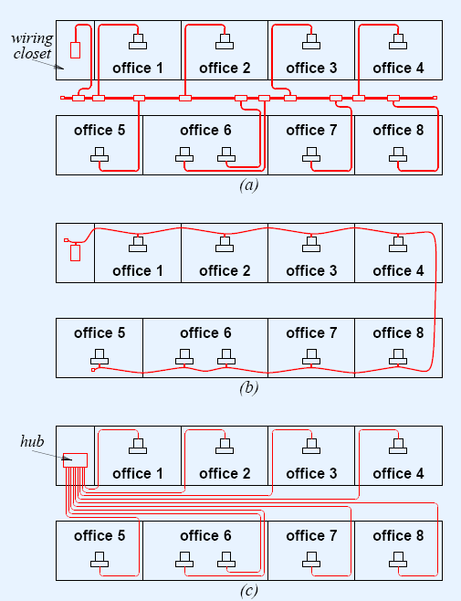
Exercise
10Base5
10Base2
10Base2
Figure adapted from:
Douglas Comer: “Computer Networks and Internets”
10BaseT
Notes:
Networks of any size can be built using the two building blocks: links and nodes

Slide 7
Topic’s objectives
To find out the answers to:
1 – What are ring topology direct-link networks?
2 – How do common wireless networks work ?

Slide 8
Ring topology
Direct-link Shared-access Networks

Slide 9
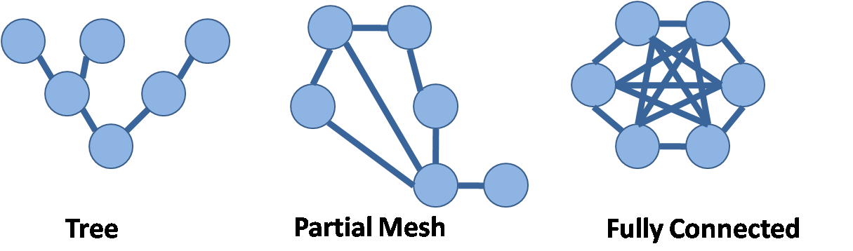
First - what is topology?
Logical and physical interconnection between nodes
Ring
Bus
Star
Typically used for direct-link shared-access networks
Point to Point
Notes:
Online resource:
http://fcit.usf.edu/Network/chap5/chap5.htm
http://en.wikipedia.org/wiki/Network_topology
From: “Computer Networks” by Stanford Rowe.
The configuration of a communication network – the way the circuits are connected together – is called the network topology. Network topologies typically used for direct-link LANs fall into three major categories:
Star Networks:
All circuits radiate from a central node,. The star network puts the central point in contact with every other location, which makes it easier to manage and control the network than is the case for some other configurations.
Drawback: The central node is a single point of failure. Another problem is that during peak traffic, the central node may become overloaded.
2) Bus Networks:
Conceptually, a bus is a communication medium to which multiple nodes are attached, and each node normally receives any signals put on the bus. The term bus implies very high speed transmission and bus networks are typically implemented in situations where the distance between all of the nodes is limited, such as LAN within a building.
3) Ring Networks:
Ring network are also usually used in LANs. Each device is connected to the ring with a tap similar to the taps found on a bus network. As communications signal pass around the ring, a receiver driver unit in each device checks the addresses of the incoming signal and either routes it to the destination device or regenerates the signal and passes it on the next device on the ring. This regeneration is a benefit of ring networks making ring networks less subject to attenuation.
Other kinds of topologies include:
Tree Topology: This is a combination of star and bus topology. It is also called an hierarchical network; in the tree topology shown above, the root node (the node below) is connected to a 2 nodes through a point to point link (these nodes are at a level below the root node). The 2nd level nodes are in turn connected to downstream nodes in star-topology.
It can also be thought of as hierarchical star networks, or star bus networks. The node having a downstream node is called a parent node, and the downstream nodes are called child nodes. A node having no child nodes is called a leaf node.
Node that the number of links is always 1 less than the number of nodes in a tree topology, and a loop cannot exist in a tree topology.
Fully Connected Topology:
In a fully connected topology, all the nodes are connected to each other.
Partial Mesh Topology:
A partial mesh topology has redundant links (contains loops), however, it’s not a fully connected network.

Slide 10
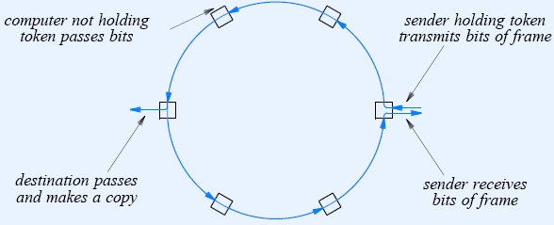
Token Ring – IEEE 802.5
Computer not holding token passes bits
Sender holding token transmits bits of frame
Destination makes a copy and passes
Sender receives frames and releases token
Figure adapted from: Douglas Comer: “Computer Networks and Internets”
Notes:
Alongside the Ethernet, token rings are the other significant class of shared-media network.
As the name suggests, a token ring network consists of a set of nodes connected in a ring (see the figure above). Data always flows in a particular direction around the ring, with each node receiving frames from its upstream neighbor and then forwarding them to its downstream neighbor. This ring-based topology is in contrast to the Ethernet’s bus topology. Like the Ethernet, however, the ring is viewed as a single shared medium; it does not behave as a collection of independent point-to-point links that just happen to be configured in a loop. Thus, a token ring shares two key features with an Ethernet: First, it involves a distributed algorithm that controls when each node is allowed to transmit, and second, all nodes see all frames, with the node identified in the frame header as the destination saving a copy of the frame as it flows past.
The word “token” in token ring comes from the way access to the shared ring is managed. The idea is that a token, which is really just a special sequence of bits, circulates around the ring; each node receives and then forwards the token. When a node that has a frame to transmit sees the token, it takes the token off the ring (i.e., it does not forward the special bit pattern) and instead inserts its frame into the ring. Each node along the way simply forwards the frame, with the destination node saving a copy and forwarding the message onto the next node on the ring. When the frame makes its way back around to the sender, this node strips its
frame off the ring (rather than continuing to forward it) and reinserts the token. In this way, some node downstream will have the opportunity to transmit a frame. The media access algorithm is fair in the sense that as the token circulates around the ring, each node gets a chance to transmit. Nodes are serviced in a round-robin fashion.
What happens when a node fails: One of the first things you might worry about with a ring topology is that any link or node failure would render the whole network useless. This problem is addressed by connecting each station into the ring using an electromechanical relay. As long as the station is healthy, the relay is open and the station is included in the ring. If the station stops providing power, the relay closes and the ring automatically bypasses the station.

Slide 11
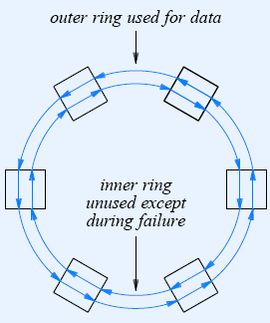
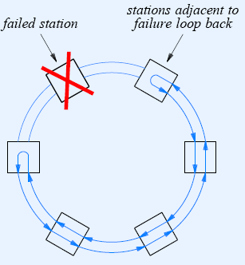
FDDI networks
Outer ring used for data
Failed station
Station adjacent to failure loop back
Inner ring unused except during failure
Figure adapted from: Douglas Comer: “Computer Networks and Internets”
Notes:
In many respects, FDDI is similar to 802.5 and IBM Token Rings. However, there are significant differences—some arising because it runs on fiber, not copper, and some arising from innovations that were made subsequent to the invention of the IBM Token Ring. We discuss some of the significant differences below.
Unlike 802.5 networks, an FDDI network consists of a dual ring—two independent rings that transmit data in opposite directions, as illustrated in Figure 2.34(a). The second ring is not used during normal operation but instead comes into play only if the primary ring fails, as depicted in Figure 2.34(b). That is, the ring loops back on the secondary fiber to form a complete ring, and as a consequence, an FDDI network is able to tolerate a single break in the cable or the failure of one station.

Slide 12
Basic paradigms of
Wireless direct-link Networks

Slide 13
Types of wireless networks
Wireless Local Area Network
Wireless Metro Area Network
Wireless Personal Area Network
Cellular Wireless
Notes:
Courtesy: Textbook – Peterson and Davie
The first step in turning nodes and links into usable building blocks is to understand how to connect them in such a way that bits can be transmitted from one node to the other. Since it is actually signals that propagate over physical links, the task is to encode the binary data that the source node wants to send
into the signals that the links are able to carry, and then to decode the signal back into the corresponding binary data at the receiving node. We ignore the details of modulation and assume we are working with two discrete signals: high and low. In practice, these signals might correspond to two different voltages on a copper-based link, or two different power levels on an optical link.

Slide 14
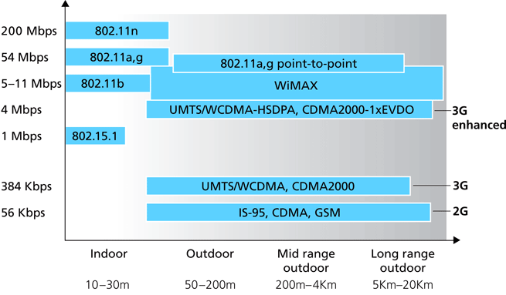
Types of wireless networks
Figure from: Kurose, Ross, “Computer Networking: a Top Down Approach”
Notes:
Credit: Wikipedia.com
Universal Mobile Telecommunications System (UMTS) is one of the third-generation (3G) mobile telecommunications technologies, which is also being developed into a 4G technology. Currently, the most common form of UMTS uses W-CDMA as the underlying air interface.
High-Speed Downlink Packet Access (HSDPA) is an enhanced 3G (third generation) mobile telephony communications protocol in the High-Speed Packet Access (HSPA) family, also coined 3.5G or 3G+, which allows networks based on Universal Mobile Telecommunications System (UMTS) to have higher data transfer speeds and capacity. Current HSDPA deployments support down-link speeds of 1.8, 3.6, 7.2 and 14.4 Mbit/s. Further speed increases are available with HSPA+, which provides speeds of up to 42 Mbit/s downlink.^{[1]}
Evolution-Data Optimized or Evolution-Data only, abbreviated as EV-DO or EVDO and often EV, is a telecommunications standard for the wireless transmission of data through radio signals, typically for broadband Internet access. It uses multiplexing techniques including Code division multiple access (CDMA) as well as Time division multiple access (TDMA) to maximize both individual user's throughput and the overall system throughput. It is standardized by 3rd Generation Partnership Project 2 (3GPP2) as part of the CDMA2000 family of standards and has been adopted by many mobile phone service providers around the world – particularly those previously employing CDMA networks.
IEEE 802.11n is a proposed amendment to the IEEE 802.11-2007 wireless networking standard to significantly improve network throughput over previous standards, such as 802.11b and 802.11g, with a significant increase in the maximum raw (PHY) data rate from 54 Mbit/s to a maximum of 600 Mbit/s. The current state of the art supports a PHY rate of 450 Mbit/s, with the use of 3 spatial streams at a channel width of 40 MHz^{[1]}. Depending on the environment, this may translate into a user throughput (TCP/IP) of 110 Mbit/s.
802.11b and 802.11g are compatible standards that use the license-free 2.4 GHz ISM band (Industrial, Scientific and Medical band) that lie around 2450 Mhz and 5800 Mhz. The respective speeds are 11 Mbps and 54 Mbps, respectively.

Slide 15
Wireless Local Area Networks
Wi-Fi (802.11)
* HiperLAN (ETSI standard)
* Details not covered in this lecture
Notes:
Wireless networking is a rapidly evolving technology for connecting computers. This section takes a closer look at a specific technology centered around the emerging IEEE 802.11 standard. Like its Ethernet and token ring siblings, 802.11 is designed for use in a limited geographical area (homes, office buildings, campuses), and its primary challenge is to mediate access to a shared communication medium—in this case, signals propagating through space. 802.11 supports additional features (e.g., time-bounded services, power management, and security mechanisms), but we focus our discussion on its base functionality.
802.11a: 54 Mbps, 5Ghz, 52-subcarrier orthogonal frequency-division multiplexing
802.11b: 11 Mbps, 2.4 GHz, DSSS (Direct-sequence spread spectrum
802.11g: OFDM for 54 Mbps and DSSS for lower rates.
HiperLAN (HIgh PErformance Radio LAN) is a Wireless LAN standard.^{[1]} It is a European alternative for the IEEE 802.11 standards (the IEEE is an international organization). It is defined by the European Telecommunications Standards Institute (ETSI). In ETSI the standards are defined by the BRAN project (Broadband Radio Access Networks).

Slide 16
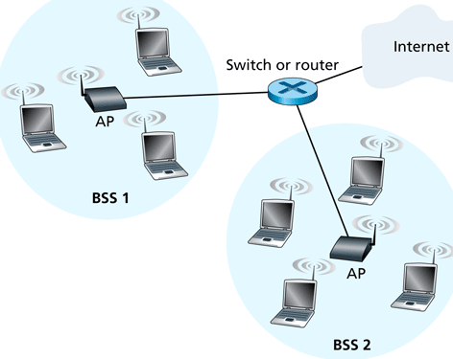
Wireless network (base station)
Infrastructure based wireless LANs
Figure from: Kurose, Ross, “Computer Networking: a Top Down Approach”

Slide 17
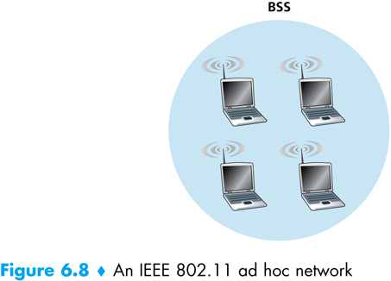
Wireless mesh (ad-hoc) network
BSS
No fixed infrastructure
Figure from: Kurose, Ross, “Computer Networking: a Top Down Approach”

Slide 18
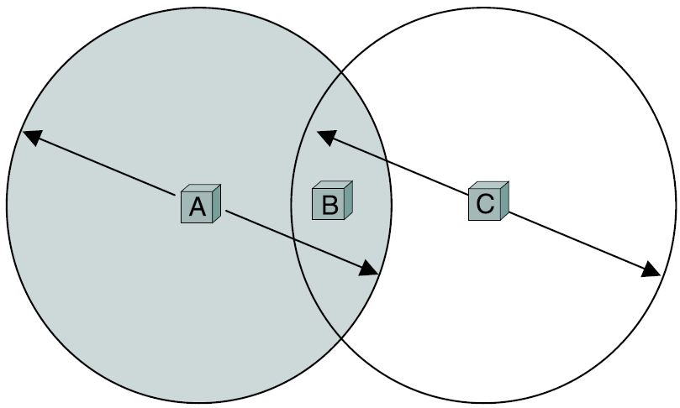
Why not use CSMA/ CD?
Figure adapted from: Peterson/ Davie: “Computer Networks – A Systems Approach”
Notes:
At first glance, it might seem that a wireless protocol would follow exactly the same algorithm as the Ethernet—wait until the link becomes idle before transmitting and back off should a collision occur—and to a first approximation, this is exactly what 802.11 does. The problem is more complicated in a wireless network, however, because not all nodes are always within reach of each other.
Consider the situation depicted in Figure 2.38, where each of four nodes is able to send and receive signals that reach just the nodes to its immediate left and right. For example, B can exchange frames with A and C but it cannot reach D, while C can reach B and D but not A. (A and D’s reach is not shown in the figure.) Suppose both A and C want to communicate with B and so they each send it a frame. A and C are unaware of each other since their signals do not carry that far. These two frames collide with each other at B, but unlike an Ethernet, neither A nor C is aware of this collision. A and C are said to be hidden nodes with respect to each other.

Slide 19
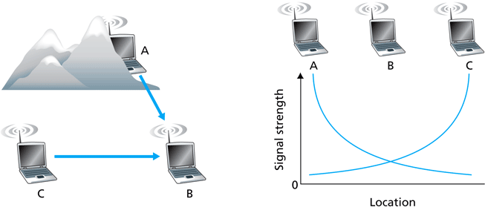
Hidden Node Problem
Caused by Obstacle
Caused by Signal Attenuation
Figure adapted from: Kurose, Ross, “Computer Networking: a Top Down Approach”
Notes:
Assume that A and C are outside the transmission range of each other and they both want to communicate with B. If A and C transmit at the same time, they will not be able to detect a collision since they are outside each others transmission range; this will lead to a collision at the receiver (B).
This problem is called a hidden node problem since the transmission is collided to by a transmission of another hidden node. The hidden node problem creates a collision at the receiver.

Slide 20
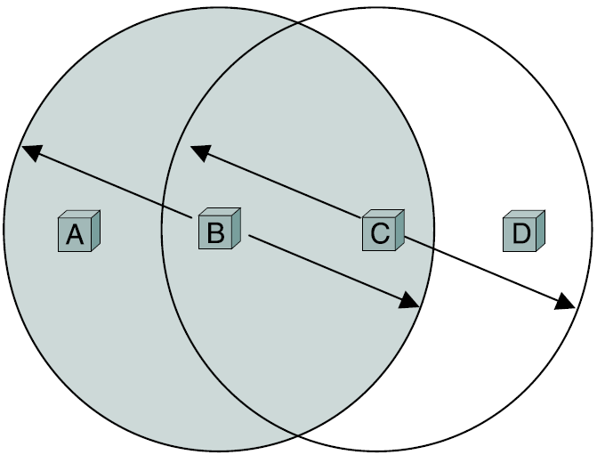
Exposed Node Problem
Figure adapted from: Peterson/ Davie: “Computer Networks – A Systems Approach”
Notes:
A related problem, called the exposed node problem, occurs under the following circumstances. Suppose B is sending to A in Figure 2.38. Node C is aware of this communication because it hears B’s transmission. It would be a mistake for C to conclude that it cannot transmit to anyone just because it can hear B’s transmission. For example, suppose C wants to transmit to node D. This is not a problem since C’s transmission to D will not interfere with A’s ability to receive from B. (It would interfere with A sending to B, but B is transmitting in our example.)

Slide 21
Collision Avoidance – RTS/ CTS
A
B
AP
RTS(B)
RTS(A)
reservation collision
RTS(A)
CTS(A)
CTS(A)
DATA (A)
defer
time
ACK(A)
ACK(A)
Notes:
802.11 addresses these two problems with an algorithm called Multiple Access with Collision Avoidance (MACA). The idea is for the sender and receiver to exchange control frames with each other before the sender actually transmits any data. This exchange informs all nearby nodes that a transmission is about to begin. Specifically, the sender transmits a Request to Send (RTS) frame to the receiver; the RTS frame includes a field that indicates how long the sender wants to hold the medium (i.e., it specifies the length of the data frame to be transmitted). The receiver then replies with a Clear to Send (CTS) frame; this frame echoes this length field back to the sender. Any node that sees the CTS frame knows that it is close to the receiver, and therefore cannot transmit for the period of time it takes to send a frame of the specified length. Any node that sees the RTS frame but not the CTS frame is not close enough to the receiver to interfere with it, and so is free to transmit.
There are two more details to complete the picture. First, the receiver sends an ACK to the sender after successfully receiving a frame. All nodes must wait for this ACK before trying to transmit.4 Second, should two or more nodes detect an idle link and try to transmit an RTS frame at the same time, their RTS frames will collide with each other. 802.11 does not support collision detection, but instead the senders realize the collision has happened when they do not receive the CTS frame after a period of time, in which case they each wait a random amount of time before trying again. The amount of time a given node delays is defined by the same exponential backoff algorithm used on the Ethernet (see Section 2.6.2).

Slide 22
CSMA/ CA algorithm - Sender
If sense channel busy then
Start random back-off time
If sense channel idle
Timer counts down while channel idle
When timer expires, wait for DIFS then
Transmit entire frame (no CD)
If no ACK received within a certain time
Increase random backoff interval, repeat from step 1
sender
receiver
DIFS
data
SIFS
ACK
Notes:
DCF (Distributed Co-ordination Function) is the MAC technique used by Wireless LANs (Infrastructure mode).
DIFS is an amount of interval, called the DCF Interframe Space, which a node waits before transmitting if the channel is found idle.
SIFS, also known as the Short Interframe Space, is the time a receiver will wait before sending an ACK.

Slide 23
CSMA/ CA algorithm - Receiver
sender
receiver
DIFS
data
SIFS
ACK
If frame received OK
Return ACK after an interval (called SIFS )
(ACK needed due to hidden terminal problem)

Slide 24
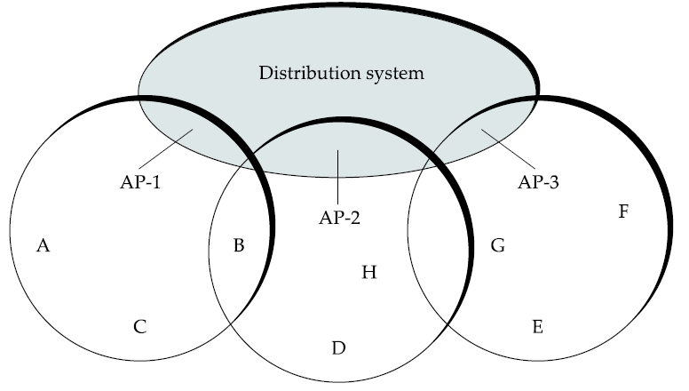
Wireless Mobility
C
Association through 1) Active Probing 2) Passive Probing
Figure adapted from: Peterson/ Davie: “Computer Networks – A Systems Approach”
Notes:
Instead of all nodes being created equal, some nodes are allowed to roam (e.g., your laptop) and some are connected to a wired network infrastructure. The latter are called access points (AP), and they are connected to each other by a so-called distribution system. The figure above illustrates a distribution system that connects three access points, each of which services the nodes in some region. Each of these regions is analogous to a cell in a cellular phone system, with the APs playing the same role as a base station.
Although two nodes can communicate directly with each other if they are within reach of each other, the idea behind this configuration is that each node associates itself with one access point. For node A to communicate with node E, for example, A first sends a frame to its access point (AP-1), which forwards the frame across the distribution system to AP-3, which finally transmits the frame to E. How AP-1 knew to forward the message to AP-3 is beyond the scope of 802.11; it may have used the bridging protocol described in the next chapter (Section 3.2). What 802.11 does specify is how nodes select their access points and, more interestingly, how this algorithm works in light of nodes moving from one cell to another.
The technique for selecting an AP is called scanning and involves the following four steps:
1 The node sends a Probe frame.
2 All APs within reach reply with a Probe Response frame.
3 The node selects one of the access points and sends that AP an Association Request frame.
4 The AP replies with an Association Response frame.
A node engages this protocol whenever it joins the network, as well as when it becomes unhappy with its current AP. This might happen, for example, because the signal from its current AP has weakened due to the node moving away from it. Whenever a node acquires a new AP, the new AP notifies the old AP of the change (this happens in step 4) via the distribution system.
Consider the situation shown in Figure 2.40, where node C moves from the cell serviced by AP-1 to the cell serviced by AP-2. As it moves, it sends Probe frames, which eventually result in Probe Response frames from AP-2. At some point, C prefers AP-2 over AP-1, and so it associates itself with that access point. The mechanism just described is called active scanning since the node is actively searching for an access point. APs also periodically send a Beacon frame that advertises the capabilities of the access point; these include the transmission rates supported by the AP. This is called passive scanning, and a node can change to this AP based on the Beacon frame simply by sending it an Association Request frame back to the access point.

Slide 25
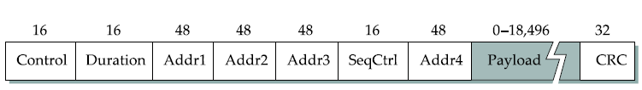
802.11 Frame
6 bit Type field: RTS/ CTS/ or Data
1 bit fields: ToDS and FromDS
When both DS bits are 1:
Addr1: Ultimate destination; Addr 4: Original sender;
Addr2: Immediate sender; Addr3: Immediate destination
Why are there 4 MAC addresses?
Figure adapted from: Peterson/ Davie: “Computer Networks – A Systems Approach”
Notes:
Most of the 802.11 frame format, which is depicted in Figure 2.41, is exactly what we would expect. The frame contains the source and destination node addresses, each of which are 48 bits long; up to 2312 bytes of data; and a 32-bit CRC. The Control field contains three subfields of interest (not shown): a 6-bit Type field that indicates whether the frame carries data, is an RTS or CTS frame, or is being used by the scanning algorithm; and a pair of 1-bit fields—called ToDS and FromDS—that are described below.
The peculiar thing about the 802.11 frame format is that it contains four, rather than two, addresses. How these addresses are interpreted depends on the settings of the ToDS and FromDS bits in the frame’s Control field. This is to account for the possibility that the frame had to be forwarded across the distribution system, which would mean that the original sender is not necessarily the same as the most recent transmitting node. Similar reasoning applies to the destination address. In the simplest case, when one node is sending directly to another, both the DS bits are 0, Addr1 identifies the target node, and Addr2 identifies the source node. In the most complex case, both DS bits are set to 1, indicating that the message went from a wireless node onto the distribution system, and then from the distribution system to another wireless node.
With both bits set, Addr1 identifies the ultimate destination, Addr2 identifies the immediate sender (the one that forwarded the frame from the distribution system to the ultimate destination), Addr3 identifies the intermediate destination (the one that accepted the frame from a wireless node and forwarded it across the distribution system), and Addr4 identifies the original source. In terms of the example given in Figure 2.39, Addr1 corresponds to E, Addr2 identifies AP-3, Addr3 corresponds to AP-1, and Addr4 identifies A.

Slide 26
Wireless Metropolitan Area Networks
WiMAX (802.16)
* HiperMAN (ETSI)
* WiBro (Korean Standard - 802.16e)
* Details not covered in this lecture
Notes:
HiperMAN stands for High Performance Radio Metropolitan Area Network and is a standard created by the European Telecommunications Standards Institute (ETSI) Broadband Radio Access Networks (BRAN) group to provide a wireless network communication in the 2 - 11 GHz bands across Europe and other countries which follow the ETSI standard.^{[1]} HiperMAN is a European alternative to WiMAX (or the IEEE 802.16 standard) and the Korean technology WiBro.
HiperMAN is aiming principally for providing broadband Wireless Internet access, while covering a large geographic area. The standardization focuses on broadband solutions optimized for access in frequency bands below 11 GHz (mainly in the 3.5 GHz band). HiperMAN is optimised for packet switched networks, and supports fixed and nomadic applications, primarily in the residential and small business user environments.
HiperMAN will be an interoperable broadband fixed wireless access system operating at radio frequencies between 2 GHz and 11 GHz.^{[2]} The HiperMAN standard is designed for Fixed Wireless Access provisioning to SMEs and residences using the basic MAC (DLC and CLs) of the IEEE 802.16-2001 standard. It has been developed in very close cooperation with IEEE 802.16,^{[3]} such that the HiperMAN standard and a subset of the IEEE 802.16a-2003 standard will interoperate seamlessly. HiperMAN is capable of supporting ATM, though the main focus is on IP traffic. It offers various service categories, full Quality of Service, fast connection control management, strong security, fast adaptation of coding, modulation and transmit power to propagation conditions and is capable of non-line-of-sight operation. HiperMAN enables both PTMP and Mesh network configurations. HiperMAN also supports both FDD and TDD frequency allocations and H-FDD terminals. All this is achieved with a minimum number of options to simplify implementation and interoperability.

Slide 27
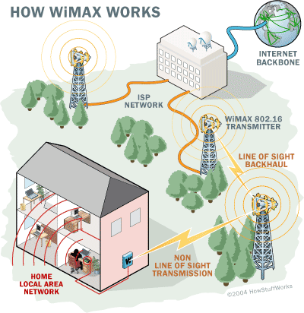
WiMAX – 802.16
Credit: www.howstuffworks.com
Notes:
WiMAX, which stands for Worldwide Interoperability for Microwave Access, was designed by the WiMAX forum and standardized as 802.16. It was originally conceived as a last mile technology. In WiMAX’s case, this ‘mile’ is typically 1 – 6 miles with a maximum of about 30 miles leading to WiMax being called a MAN.
Like 802.11 & cellular: base station model
transmissions to/from base station by hosts with omnidirectional antenna
base station-to-base station backhaul with point-to-point antenna
Unlike 802.11:
range ~ 6 miles (“city rather than coffee shop”)
~14 Mbps

Slide 28


Wireless Personal Area Networks
Bluetooth (802.15.1)
Zigbee (802.15.4)
Notes:
Bluetooth fills the niche of very short-range communication between mobile phones, PDAs, notebook computers, and other personal or peripheral devices. Bluetooth operates in the license exempt band at 2.45 GHz. It has a range of only about 10 m. For this reason, and because the communicating devices typically belong to a single individual/ group, Bluetooth is sometimes referred to as a ‘personal area network’. Version 2.0 provides speed up to 2.1 Mbps.
Bluetooth is specified by an Industry consortium called the Bluetooth Special Interest Group (SIG). It specifies an entire suite of protocols, going beyond the link layer to define application protocols, which it defines profiles. For example, there is a profile for synchronizing a PDA with a personal computer.
The 802.15.1 standard is based on Bluetooth but excludes the application protocols.
Zigbee is a newer technology that competes with Bluetooth to some extent. Devised by the ZigBee alliance and standardizes as 802.15.4, it is designed for situations where the bandwidth requirements are low and power consumption must be very low to give very long battery life. It is also intended to be cheaper and simpler than Bluetooth making it financially feasible to incorporate in cheaper devices such as a wall switch that wirelessly communicates with a ceiling mounted fan.

Slide 29
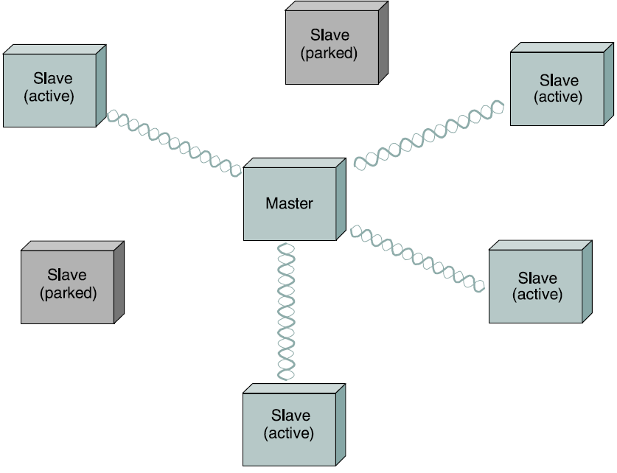
Bluetooth – 802.15.1
Wireless Personal Area Network (WPAN)
Figure adapted from: Peterson/ Davie: “Computer Networks – A Systems Approach”
Notes:
From the textbook – 4th edition:
The basic Bluetooth network configuration, called a Piconet, consists of a master device and up to seven slave devices. Any communication is between a master and a slave; the slaves do not talk directly with each other. Because slaves have a simpler role, their Bluetooth hardware and software can be simpler and cheaper.
Since Bluetooth operates in license-free band, it is required to use a spread spectrum technique to deal with possible interference in the band. It uses frequency hopping with 79 channels (frequencies) using each for 625us at a time. This provides a natural time slot for Bluetooth to use for synchronous TDM. A frame takes up 1, 3, or 5 consecutive time slots.
Only the master can start to transmit in odd-numbered slots. A slave can start to transmit in an even-numbered slot, but only in response to a request from the master during the previous slot, thereby preventing any contention between slave devices.
A slave device can be parked, that is set to an inactive, low-power state. A parked device cannot communicate on the Piconet; it can only be reactivated by the master. A Piconet can have up to 255 parked devices in addition to its active slave devices.
From Wikipedia:
Bluetooth is an open wireless protocol for exchanging data over short distances from fixed and mobile devices, creating personal area networks (PANs). It was originally conceived as a wireless alternative to RS232 data cables. It can connect several devices, overcoming problems of synchronization.
Bluetooth uses a radio technology called frequency-hopping spread spectrum, which chops up the data being sent and transmits chunks of it on up to 79 frequencies. In its basic mode, the modulation is Gaussian frequency-shift keying (GFSK). It can achieve a gross data rate of 1 Mb/s. Bluetooth provides a way to connect and exchange information between devices such as mobile phones, telephones, laptops, personal computers, printers, Global Positioning System (GPS) receivers, digital cameras, and video game consoles through a secure, globally unlicensed Industrial, Scientific and Medical (ISM) 2.4 GHz short-range radio frequency bandwidth. The Bluetooth specifications are developed and licensed by the Bluetooth Special Interest Group (SIG). The Bluetooth SIG consists of companies in the areas of telecommunication, computing, networking, and consumer electronics.^{[4]}

Slide 30
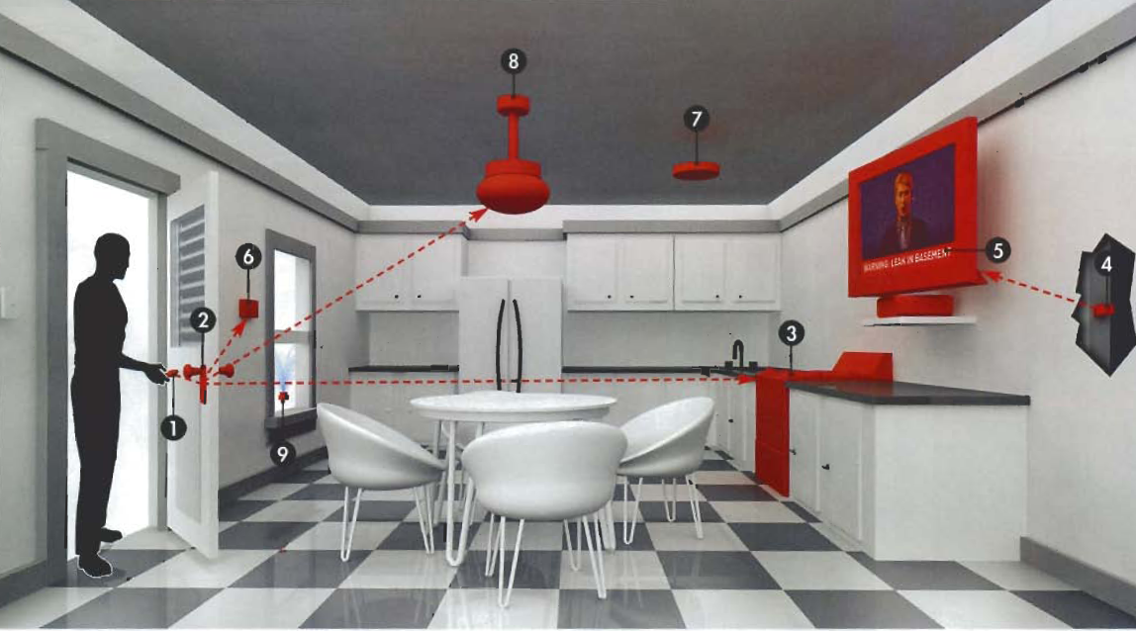
Zigbee – 802.15.4
Wireless Personal Area Network (WPAN)
Source: http://www.zigbee.org/imwp/idms/popups/pop_download.asp?ContentID=7092
Notes:
Zigbee:
The ZigBee Alliance is an association of companies working together to enable reliable, cost-effective, low-power, wirelessly networked, monitoring and control products based on an open global standard.
The goal of the ZigBee Alliance is to provide the consumer with ultimate flexibility, mobility, and ease of use by building wireless intelligence and capabilities into everyday devices. ZigBee technology will be embedded in a wide range of products and applications across consumer, commercial, industrial and government markets worldwide. For the first time, companies will have a standards-based wireless platform optimized for the unique needs of remote monitoring and control applications, including simplicity, reliability, low-cost and low-power.
Some applications (as shown above)
Meet and Greet (1 and 2 and 3)
Sensible Sensors (4 and 5)
Climate Control (6)
Safer Space (7)
No-hassle light (8)
Smart sprinkler (9)

Slide 31
Cellular networks
3G

Slide 32
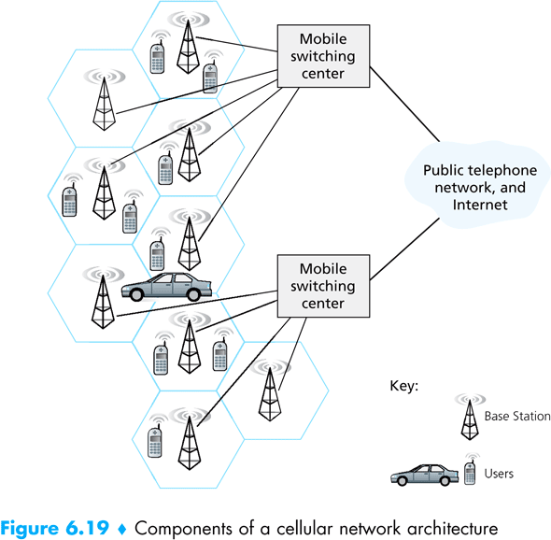
Cellular 3G
Mobile Switching Center
Public telephone network, and Internet
Mobile Switching Center
Legends:
Base Station
Users
Figure adapted from: Kurose, Ross, “Computer Networking: a Top Down Approach”
Notes:
3G is the third generation of telecommunication hardware standards and general technology for mobile networking, superseding 2.5G. It is based on the International Telecommunication Union (ITU) family of standards under the IMT-2000.^{[1]}
3G networks enable network operators to offer users a wider range of more advanced services while achieving greater network capacity through improved spectral efficiency. Services include wide-area wireless voice telephone, video calls, and broadband wireless data, all in a mobile environment. Additional features also include HSPA data transmission capabilities able to deliver data rates up to 14.4 Mbit/s on the downlink and 5.8 Mbit/s on the uplink.
Unlike IEEE 802.11 networks, which are commonly called Wi-Fi or WLAN networks, 3G networks are wide-area cellular telephone networks that evolved to incorporate high-speed Internet access and video telephony. IEEE 802.11 networks are short range, high-bandwidth networks primarily developed for data.

Slide 33


References
Section 2.8:
Direct Link Networks [P&D]
Chapter 6:
Wireless and Mobile Networks [K&R]

Slide 34
?
?
Questions/ Confusions?
?
Use the discussion forum at:
http://compnets.ning.com/
Credits/ Acknowledgement at:
http://sites.google.com/site/cse320site/

